Slide 1
Buddy Review & Git workflows
COMP23420: Software Engineering
Week 4
Markel Vigo

Slide 2
Course Unit Roadmap (Weeks 2-10)
Skills for Small Code Changes
Working with source code repositories
Skills for Adding Features
Estimating for software change
Coding defensively
Code review
Design for testability
Larger-Scale Change
Software architecture
Domain specific languages
Safe migration of functionality
Debug
Test
Code reading
Week | 2 | 3 | 4 | 5 | 6 | 7 | 8 | 9 | 10
Notes:
This roadmap just shows when the content is taught, during weeks 2-10. Please can all lecturers display this roadmap near the start of each workshop, to help students keep oriented in the material we are presenting.

Slide 3
Coursework deadlines
Deadline is Friday 5.00PM
You are going to be marked based on the contents of the repo
Marking will happen the next week
Face-to-face
With TAs
At the team study sessions
Schedule on Moodle

Slide 4
Link to the Coursework/Exam
We will learn basic Git workflows including
Branch creation
Branch merging
Conflict resolution
On the command line, Eclipse and GitLab
We will learn how important code reviews are
How code reviews can be incorporated onto distributed version control systems and their workflows

Slide 5
Outline
Times are estimated
Motivation 5’
Git workflows 15’
Git workflows: branch creation 35’
Break? 10’
Code reviews 10’
Git workflows: branch merging 35’

Slide 6

Motivation

Slide 7
Motivation
Software engineering is not an individual activity
Challenges:
Working with people
Working in distributed teams
Working with others’ code
Key challenges (and opportunities):
Group coordination
Codebase synchronisation
Quality assurance

Slide 8
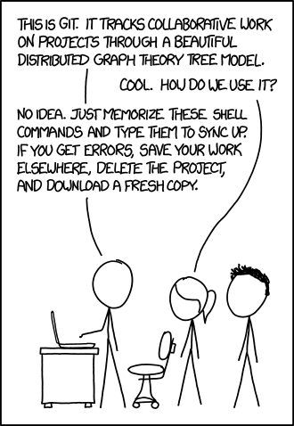
Git workflows

Slide 9
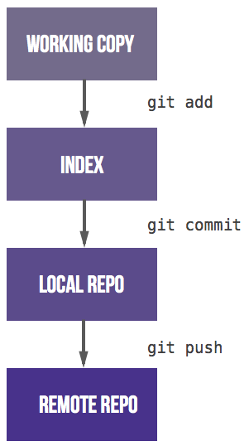
Basic Git: what you should know
Git is a distributed version control system
The life cycle of a file under git’s control

Slide 10
Git: what you should know
Basic git commands and their interaction with various repositories

Slide 11
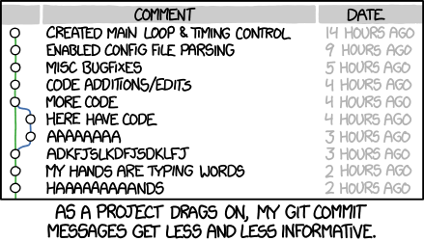
Git: best practice
A commit should represent one conceptual change to your work
Expressed in one sentence
One commit per bug
Do commit frequently
Do not commit unfinished things
Write meaningful messages

Slide 12
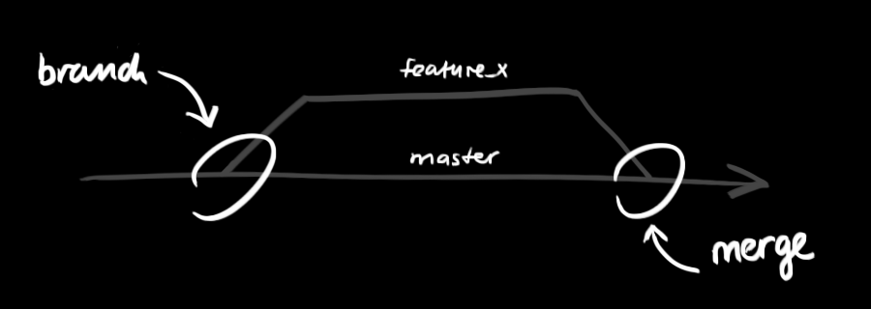
Branching
Branches are used to develop features isolated from each other.
The master branch is the “default” branch when you create a repository
Use other branches for development and merge them back to the master branch upon completion.
http://rogerdudler.github.io/git-guide/

Slide 13
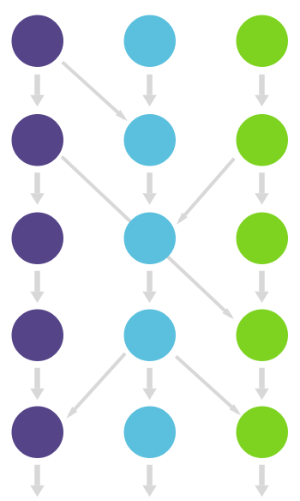
Git workflows
Branching allows a wide variety of strategies
This flexibility can result in complex, intertwined and messy ways of developing code
Using Git stops being efficient
A ‘code of conduct’ or protocol or conventions are needed
Patterns for Git use: Git workflows
http://rogerdudler.github.io/git-guide/

Slide 14
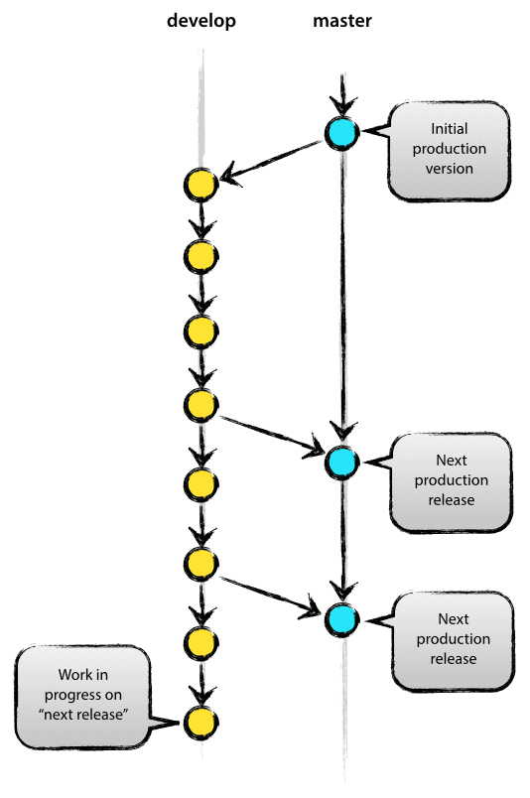
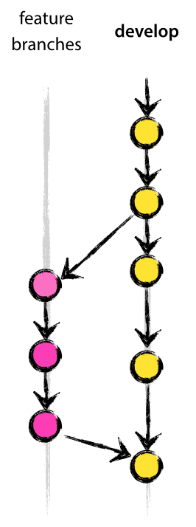
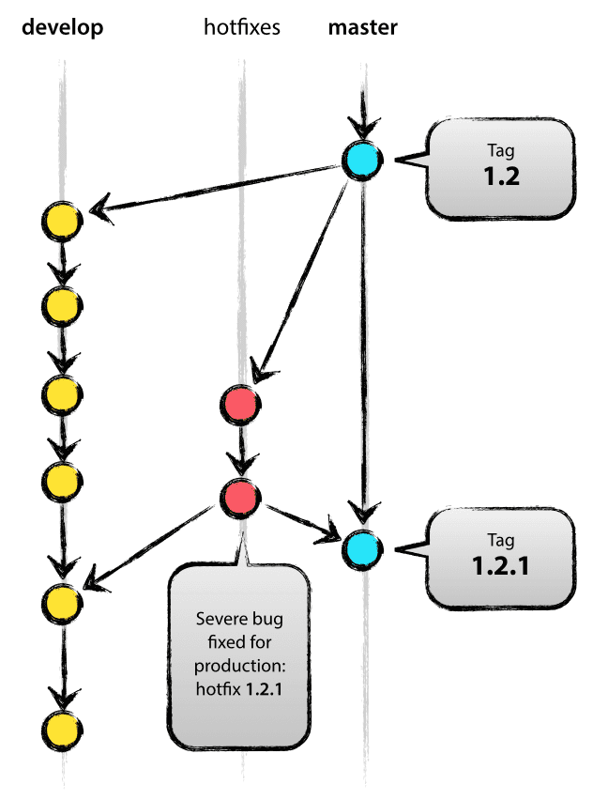

Git workflows
The GitFlow model
Two main branches
Master: production code
Develop: latest development
Supporting branches
Feature branches
Hotfix branches
Release branch
Positive aspects
Popular workflow
Negative aspects
Still complex!
Notes:
Feature branches derive from develop and planned
Hotfix are bugs and unplanned and critical
Release branches support preparation of a new production release and minor bug fixing

Slide 15
Git workflows
The GitHub Flow model as a reaction
Master branch
Feature branches
GitHub Flow assumes you are able to deploy every time you merge a feature branch
Simplification and reduction of branch types
GitLab Flow simplifies this even more
Confusion: different repository managers use different terminology for merging!
Gitlab and Gitorious: merge request
GitHub and BitBucket: pull request
Notes:
Gitlab flow proposes to create release branches on the fly

Slide 16

Practicing Git workflows: branching
‘On the Road’ by Jack Kerouac
Job description: you are the publisher of the book and you have received the first chapter.
You will request different chapters to complete the book.
We will have the master branch for the title and chapter 1
We will create one branch for
chapter 2 in the command line
chapter 3 in GitLab
chapter 4 in Eclipse

Slide 17

Break: 10 minutes

Slide 18
Code reviews

Slide 19
Code reviews
Having the coder reviewed by somebody else is good
It can be done in several ways:
Formal meeting with a projector and code is checked line by line
‘Over the shoulder’
Email
Pair programming
Tool based
It improves the quality, readability and maintainability of software.
It has an average of 60% of defect removal rate (even 85%) vs. 25% of unit testing
Notes:
OpenStack code review

Slide 20
Code review: what to report
Code review rates should be between 200 and 400 lines of code per hour
What sort of issues?
Design issues
Possible errors
Coding style issues
Testing issues
Rewards: positive comments
How to do the reviews?
Be nice
Be constructive (somebody else will look at yours!)
It’s good for your own soft skills
Notes:
Careful about the statement

Slide 21
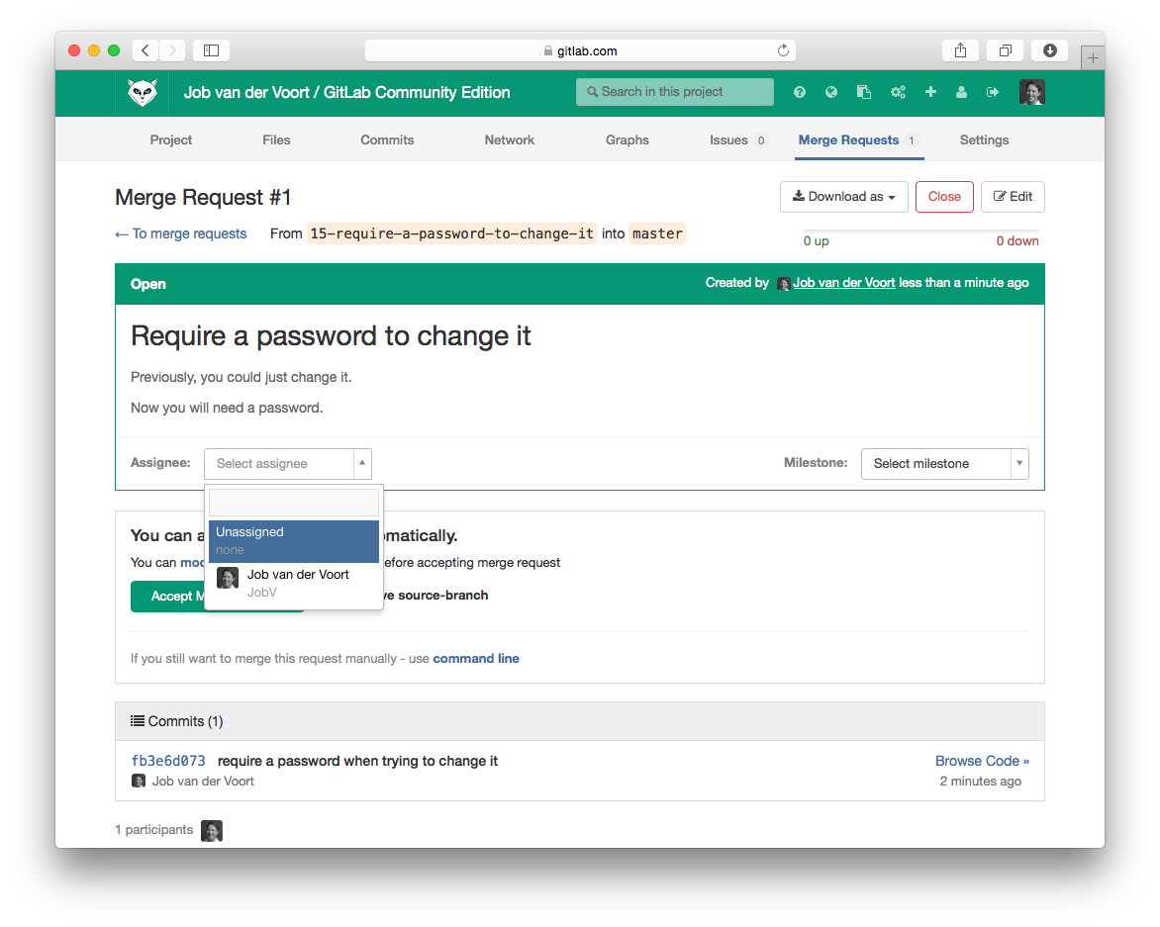
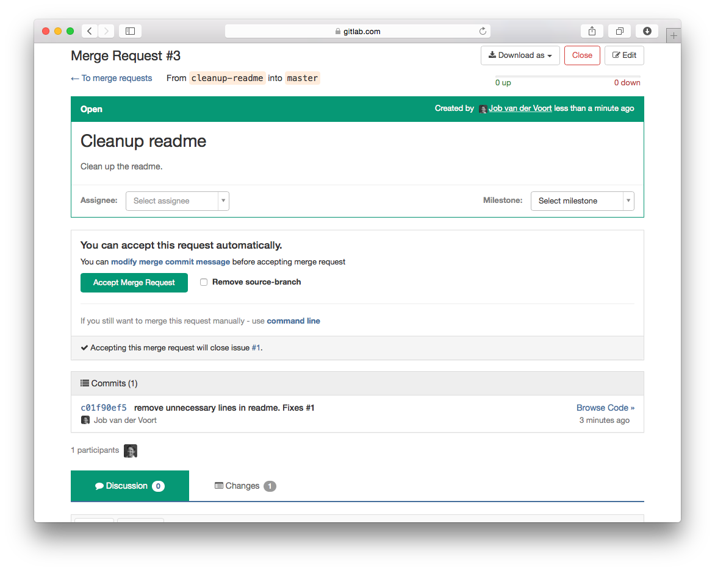
Code reviews in the GitLab workflows
GitLab provides a online platform to discuss the code
Code reviews on merge requests
Assign the request to somebody else
This person will verify(through code reviews)
If happy with request they accept the merge
If not they may require further work
1
2

Slide 22
Practicing Git workflows: merging
‘On the Road’ by Jack Kerouac
Job description: you are the publisher of the book and you have received the first chapter.
You will request different chapters to complete the book.
We will have the master branch for the title and chapter 1
We will merge
chapter 2 from GitLab
chapter 3 from the command line
chapter 4 from Eclipse

Slide 23
Next Week
In the team study sessions you will work on the coursework
In the workshop we will learn to estimate the cost of bug fixing and adding new features
Notes:
Please end your workshop with a slide that tells students what is coming up next week.
For the Thursday workshop, remember that there is a team study session following straight after it. Remind the students to attend. Make clear that what is described on this slide refers to next week’s team study sessions, not the one that follows.

